Slide 1
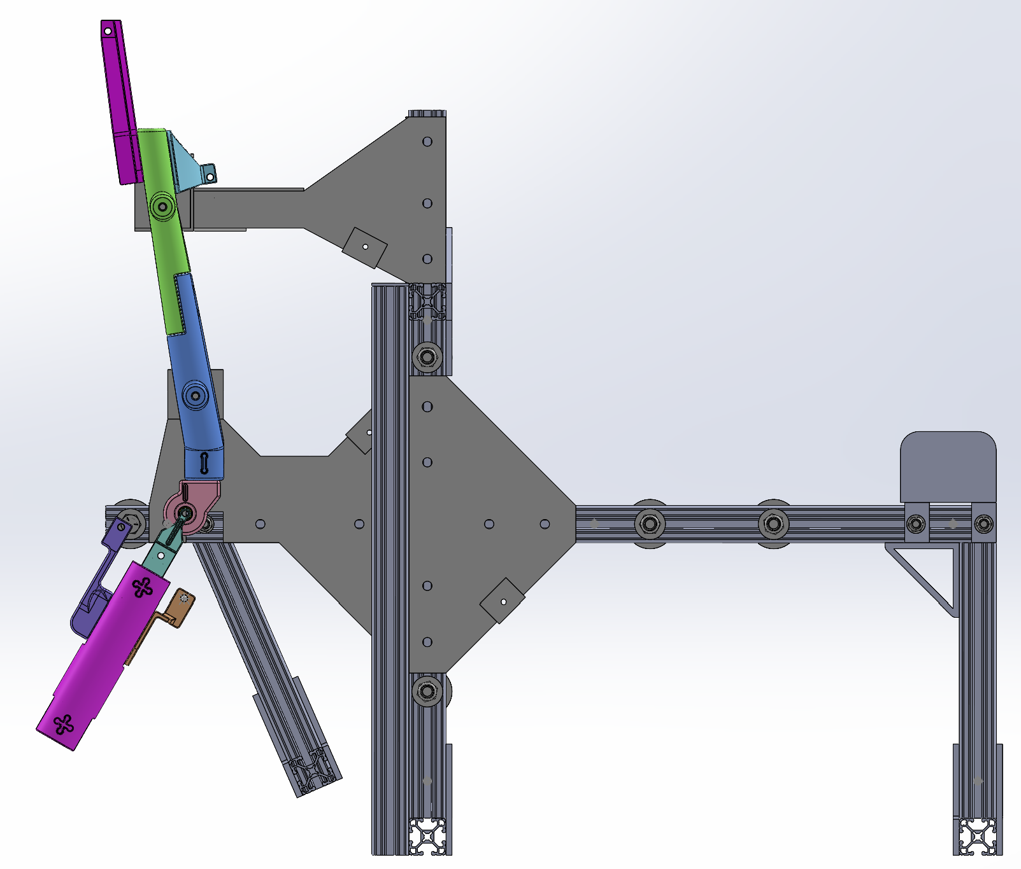
Test jig assembly
mounting locations
BPA
Femur
Winch housing
Knee joint
Tibia
θ
Winch cable
Swing arm
Load cell

